Slide 1
APACHE PIG
SIRISHA PAKALAPATI
16161825

Slide 2
OUTLINE
Motivation
Background
Components
How it Works with Map Reduce
Pig Latin by Example
Wrap up & Conclusions

Slide 3
MOTIVATION
Map Reduce is very powerful,
but:
– It requires a Java programmer.
– User has to re-invent common functionality (join, filter, etc.)

Slide 4
PIG LATIN
Pig provides a higher level language, Pig Latin, that:
– Increases productivity. In one test
• 10 lines of Pig Latin ≈ 200 lines of Java.
• What took 4 hours to write in Java took 15minutes in Pig Latin.
– Opens the system to non-Java programmers.
– Provides common operations like join, group, filter, sort.

Slide 5
PIG ENGINE
Pig provides an execution engine atop Hadoop
– Removes need for users to tune Hadoop
for their needs.
– Insulates users from changes in Hadoop
interfaces.

Slide 6
WHY PIG
Pig Latin is a data flow language rather than procedural or declarative.
User code and existing binaries can be included almost anywhere.
Support for nested types.
Operates on files in HDFS.

Slide 7
How Pig is Being Used
Web log processing.
Data processing for web search platforms.
Ad hoc queries across large data sets.
Rapid prototyping of algorithms for processing large data sets.

Slide 8
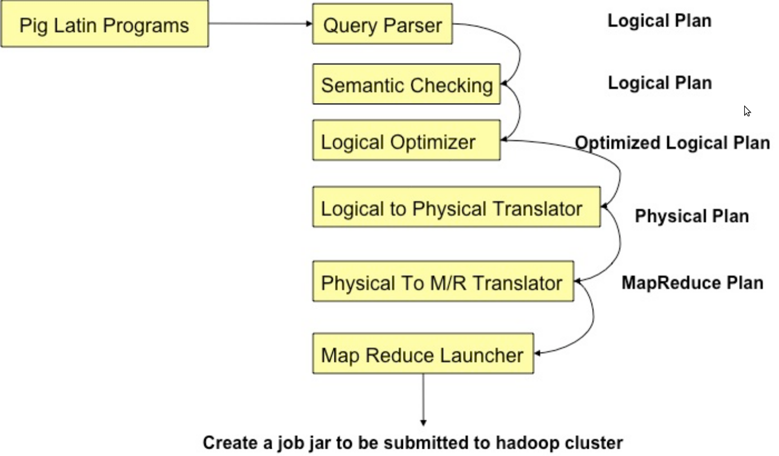
Compilation

Slide 9
Parsing
Type checking with schema
References verifying
Logic plan generating
One-to-one fashion
Independent of execution platform
Limited optimization

Slide 10
Logic Plan
A=LOAD 'file1' AS (x, y, z);
B=LOAD 'file2' AS (t, u, v);
C=FILTER A by y > 0;
D=JOIN C BY x, B BY u;
E=GROUP D BY z;
F=FOREACH E GENERATE
group, COUNT(D);
STORE F INTO 'output
load
load
filter
join
group
foreach
store

Slide 11
Physical Plan
1:1 correspondence with most logical operators
Except for:
DISTINCT
(CO)GROUP
JOIN
ORDER

Slide 12
Map Reduce Plan
Determine Map Reduce boundaries
GLOBAL REARRANGE
Some operations are done by Map Reduce framework
Coalesce other operators into Map & Reduce stages
Generate job jar file

Slide 13
DATA TYPES
Scalar types: int, long, double, char array, byte array.
Complex types:
– map: associative array.
– tuple: ordered list of data, elements may be of any scalar or complex type.
– bag: unordered collection of tuples.

Slide 14
PIG COMMANDS
Load –Read the data from the file.
Store-writes the data to the file.
Foreach-Apply expressions to each record and output one or more records.
Filter-Apply predicate and remove records that do not return true.
group/cogroup-Collect records with the same key from one or more inputs.

Slide 15
PIG COMMANDS-2
Join-Join two or more inputs based on a key.
Order-Sort records based on a key.
Distinct-Remove duplicate records.
Union-Merge two data sets
split -Split data into 2 or more sets, based on filter conditions.
Stream-Send all records through a user provided binary.

Slide 16
Application demo

